Slide 1
Top-Down Design with Functions and Classes
COS 1020 C++ Programming
AUBG COS Department
Based on chapter 3 – problem solving, abstraction and design using C++, Friedman & Koffman

Slide 2
Lecture Contents
3.2 Library Functions
3.3 Top-Down Design and Structure Charts
3.4 Functions without Arguments
3.5 Functions with Input Arguments
3.6 Scope of Names
3.7 Extending C++ through Classes: Using Class string

Slide 3
Library Functions
One of the important goals of software engineering is writing reliable error-free code
One way to achieve this is through code reuse – reusing program fragments that have already been written and tested
C++ promotes code reuse by providing predefined classes and functions in the standard library

Slide 4
C++ cmath Library
Contains many typical mathematical functions – e.g. sqrt, sin, cos, log
Function used in an assignment statement:
y = sqrt(x);
Function call
Function name
Function argument

Slide 5
Functions as Black Boxes
Function sqrt as a “black box” – receives data and returns data
  y = sqrt(x);
Square root function
X is 16.0
Result is 4.0

Slide 6
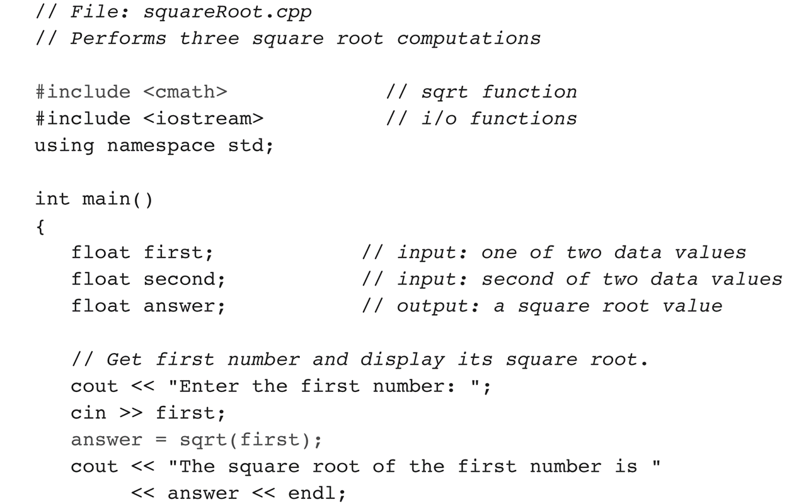
Example: Using the sqrt Function

Slide 7
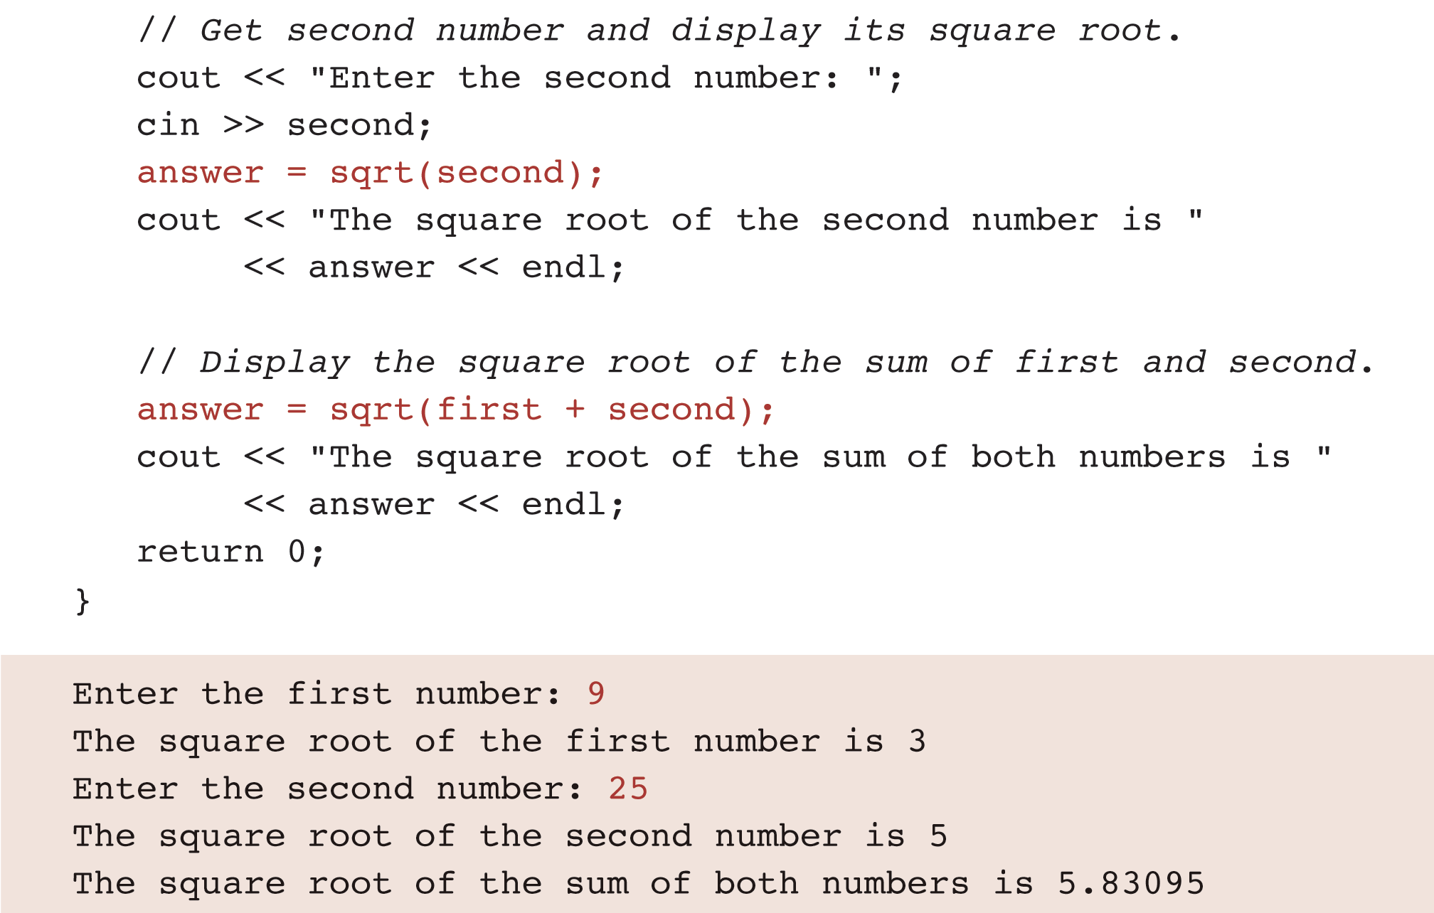
Example: Using the sqrt Function (continued)

Slide 8
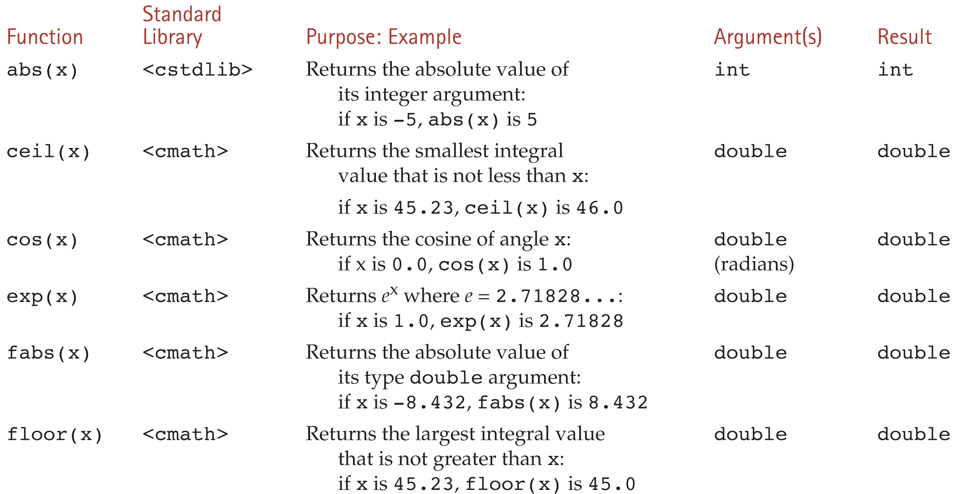
Some Mathematical Library Functions

Slide 9
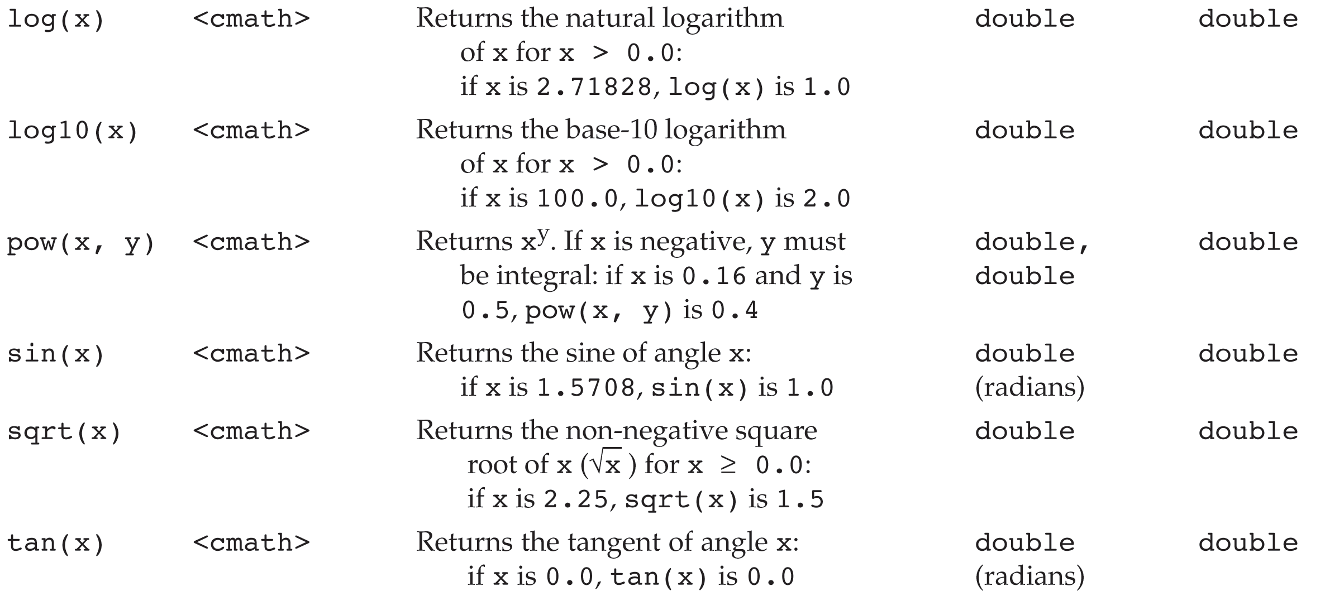
Some Mathematical Library Functions (continued)

Slide 10
Looking Ahead
C++ allows us to write our own functions like:
  findArea(r) – returns area of a circle with radius r
  findCircum(r) – returns perimeter of a circle
We could use the above two functions in a program like:
area = findArea(r);
perim = findCircum(r);
rimArea = findArea(outer) - findArea(inner);

Slide 11
Top-Down Design and Structure Charts
Algorithms used to solve problems are usually complex
Programmers use a method called Top-down Design – repeatedly breaking a problem into subproblems and solving them to derive the solution of the original problem
A structure chart can be used to show the relationships among and different levels of subproblems

Slide 12
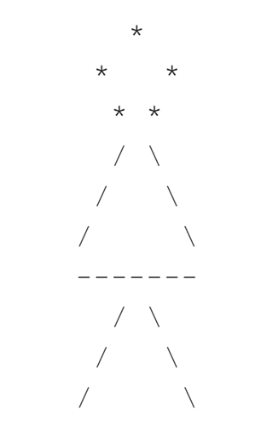
Example: Structure Chart
Original Problem
Subproblems
Detailed
Subproblems

Slide 13
Functions without Arguments
One way programmers use top-down design in their programs is by writing their own functions for each subproblem in the structure chart
The main() function in a program is called by the OS
The general form of a function call statement:
  fname();
Example:
  drawCircle();

Slide 14
Some Notes on Functions
We do not need to know any details about how a function is implemented, in order to call it
For example:
  y = sqrt(x); // don’t know how sqrt implemented
However, we do need to know how a function is used (called)
Empty parentheses indicate that no arguments are passed to the function (more on this later)

Slide 15
Function Prototype / Declaration
Just like other identifiers in C++, a function must be declared before it can be referenced
A function prototype declares to the compiler
Usually appears before the main() function
Contains the function type (of the return value), its name and information about its parameters

Slide 16
Function Prototype (No Arguments)
General form:
  ftype fname();
Example:
  void skipThree();
Interpretation:
  The identifier fname is declared to be the name of the function.
  The identifier ftype specifies the data type of the function result.
  A function type void indicates that the function does not return a value.

Slide 17
Function Definition
Specifies the function’s operations
Function header similar to function prototype
Function body contains declarations for local variables and constants and executable statements
Prototypes usually precede main function (after the #include directives)
Function definitions follow main function

Slide 18
Function Definition (No Arguments)
Syntax:
  ftype fname()
  {
  local variable declarations;
  executable statements;
  }
Example:
void printName()
{
cout << "John Smith" << endl;
}

Slide 19
Skipping Function Prototype / Declaration
#include <iostream>
using namespace std;
void showMsg()
{
cout << "Hello World!" << endl;
}
int main()
{
showMsg();
return 0;
}

Slide 20
Skipping Function Prototype / Declaration (continue)
#include <iostream>
using namespace std;
void showMsg();
int main()
{
showMsg();
return 0;
}
void showMsg()
{
cout << "Hello World!" << endl;
}

Slide 21
Order of Execution
int main( )
{
drawCircle( );
drawTriangle( );
drawIntersect( );
return 0;
}
void drawCircle( )
{
cout << “ * “ << endl;
cout << “ * * “ << endl;
cout << “ * * “ << endl;
//return to calling function
} // end drawCircle

Slide 22
Notes on Function Execution
Program execution always begins at the first statement of the main function
When a function is called
  Memory space is set aside for function variables
  Statements of the function are executed
  Control returns to the statement following the function call
  Function ends with memory space released

Slide 23
Function Advantages
A team of programmers can work on larger projects – each member will be responsible for a particular set of functions
Functions simplify tasks because existing ones can be reused in other programs
Functions allow procedural abstraction – a technique in which the more abstract functions (like main) consist of sequence of other function calls
Can be used to implement the different layers of subtasks in a top-down approach

Slide 24
Displaying User Instructions
Simple functions (no arguments, no return value) have limited capability
They are useful for displaying constant data, like instructions to the user
Example:
void instruct(); // prototype
...
instruct(); // function call

Slide 25
Example: Function instruct
// Displays instructions to the user of a program
void instruct()
{
cout << "This program computes the area and " << endl;
cout << "circumference of a circle. " << endl << endl;
cout << "To use this program, enter the radius of the " << endl;
cout << "circle after the prompt" << endl;
cout << "Enter the circle radius: " << endl << endl;
cout << "The circumference will be computed in the same" << endl;
cout << "units of measurement as the radius. The area " << endl;
cout << "will be computed in the same units squared." << endl << endl;
}

Slide 26
Functions with Input Arguments
Programmers use functions like building blocks to construct large programs
The arguments of a function are used to pass information from the main (or another) function to the current one (input arguments), or to return multiple results (output arguments)
Arguments make functions flexible:
rimArea = findArea(edgeRadius) - findArea(holeRadius);

Slide 27
void Functions with Input Arguments
Pass data to function to use
Do not expect function to return any result(s)
Call format:
fname(actual-argument-list);
Example:
drawCircleChar('*');

Slide 28
Example: Function Input Argument
drawCircleChar('*');
symbol
void drawCircleChar(char symbol)
{
cout << " " << symbol << endl;
cout << " " << symbol << " " << symbol << endl;
cout << " " << symbol << " " << symbol << endl;
} // end drawCircle
'*'

Slide 29
Functions with Arguments and a Single Result
Functions that return a result must have a return statement
General form:
  return expression;
Example:
return x * y;

Slide 30
Example: Circle Area and Circumference
#include <iostream>
#include <cmath>
using namespace std;
const float PI = 3.14159;
float findCircum(float);
float findArea(float);
int main() {
float radius = 10.0, perimeter, area;
perimeter = findCircum(radius);
area = findArea(radius);
cout << "Area is " << area << endl;
cout << ”Perimeter is " << perimeter << endl;
return 0;
}

Slide 31
Example: Circle Area and Circumference (continued)
// Computes the circumference of a circle with radius r
// Pre: r is defined and is > 0.
// PI is a constant.
// Post: returns circumference
float findCircum(float r) {
return (2.0 * PI * r);
}
// Computes the area of a circle with radius r
// Pre: r is defined and is > 0.
// PI is a constant.
// Post: returns area
float findArea(float r) {
return (PI * pow(r, 2));
}

Slide 32
Example: Function with Input Argument and Return Value
circum = findCircum(radius);
circum
radius
call findCircum
62.8318
10
float findCircum(float r)
{
return (2.0 * PI * r);
}
r
10
62.8318

Slide 33
Function Definition (Input Arguments with One Result)
General form:
// function interface comment
ftype fname(formal-parameter-declaration-list)
{
local variable declarations
executable statements
}

Slide 34
Example: Function Definition (Input Arguments with One Result)
// Finds the cube of its argument.
// Pre: n is defined.
int cube(int n)
{
return (n * n * n);
}

Slide 35
Function Prototype (With Parameters)
Form:
ftype fname(formal-parameter-type-list);
Example:
int cube(int);
  or
int cube(int n);

Slide 36
Problem Inputs vs. Input Parameters
Problem inputs
  Variables that receive data from the user
  Collected through execution of input statements
Input parameters
  Receive data through execution of function call statement
  Must be defined before function is called

Slide 37
Example: Testing function testScale.cpp
// File testScale.cpp
// Tests function scale.
#include <iostream>
#include <cmath>
using namespace std;
// Function prototype
float scale(float, int);

Slide 38
Example: Testing function testScale.cpp (continued)
int main()
{
float num1;
int num2;
// Get values for num1 and num2
cout << "Enter a real number: ";
cin >> num1;
cout << "Enter an integer: ";
cin >> num2;
// Call scale and display result.
cout << "Result of call to function scale is "
<< scale(num1, num2) << endl;
return 0;
}

Slide 39
Example: Testing function testScale.cpp (continued)
// Multiplies its first argument by the power of 10
// specified by its second argument.
// Pre: x and n are defined and library cmath is included
float scale(float x, int n)
{
float scaleFactor; // local variable
scaleFactor = pow(10, n);
return (x * scaleFactor);
}

Slide 40
Example: Testing function testScale.cpp (continued)
cout << "Result of call to function scale is "
<< scale(num1, num2)
<< endl;
Actual arguments
.
.
.
Information flow
float scale(float x, int n)
{
float scaleFactor; // local variable
scaleFactor = pow(10, n);
return (x * scaleFactor);
}
Formal parameters

Slide 41
Argument/Parameter List Correspondence
Functions must have the same number of formal parameters and actual arguments
The order of arguments in the lists determines correspondence
Each actual argument must be of a data type that is compatible to the corresponding formal parameter
The names of the actual arguments do not need to correspond to the formal parameter names

Slide 42
Function Data Area
Each time a function is executed
  An area of memory is allocated for storage of the function’s data (formal parameters and local variables)
  It is created empty with each call to the function
When the function terminates
  The data area is lost

Slide 43
Testing Functions Using Drivers
Any function can be tested independently
A test driver
  Defines values for the function’s arguments
  Calls the function
  Displays the value returned for verification

Slide 44
Summary
float findArea(float);
int main() {
float radius = 20.0, area;
area = findArea(radius);
}
float findArea(float r) {
return (PI * pow(r, 2));
}
-> Prototype
-> Invocation
-> Signature/Header
-> Body of a function
Definition

Slide 45
Summary (continued)
void instruct();
int main() {
instruct();
}
void instruct() {
cout << “instructions” << endl;
}
-> Prototype
-> Invocation
-> Signature/Header
-> Body of a function
Definition

Slide 46
Questions?
Q & A

Slide 47
Scope of Names
Scope – the region of a program where a particular variable can be referenced
Local – can be referred to only within the function
  Formal parameter names
  Constants and variables declared within the function
Global – can be referred to within all functions
  Useful for constants
  Must be used with care

Slide 48
Scope of Names (continued)
int myFunc(int x) {
int sum = 0;
for (int i = 0; i < x; i++) {
sum += i;
}
cout << i << endl;
return sum;
}
int main() {
int t = 10;
cout << myFunc(t) << endl;
cout << x << endl;
cout << sum << endl;
}

Slide 49
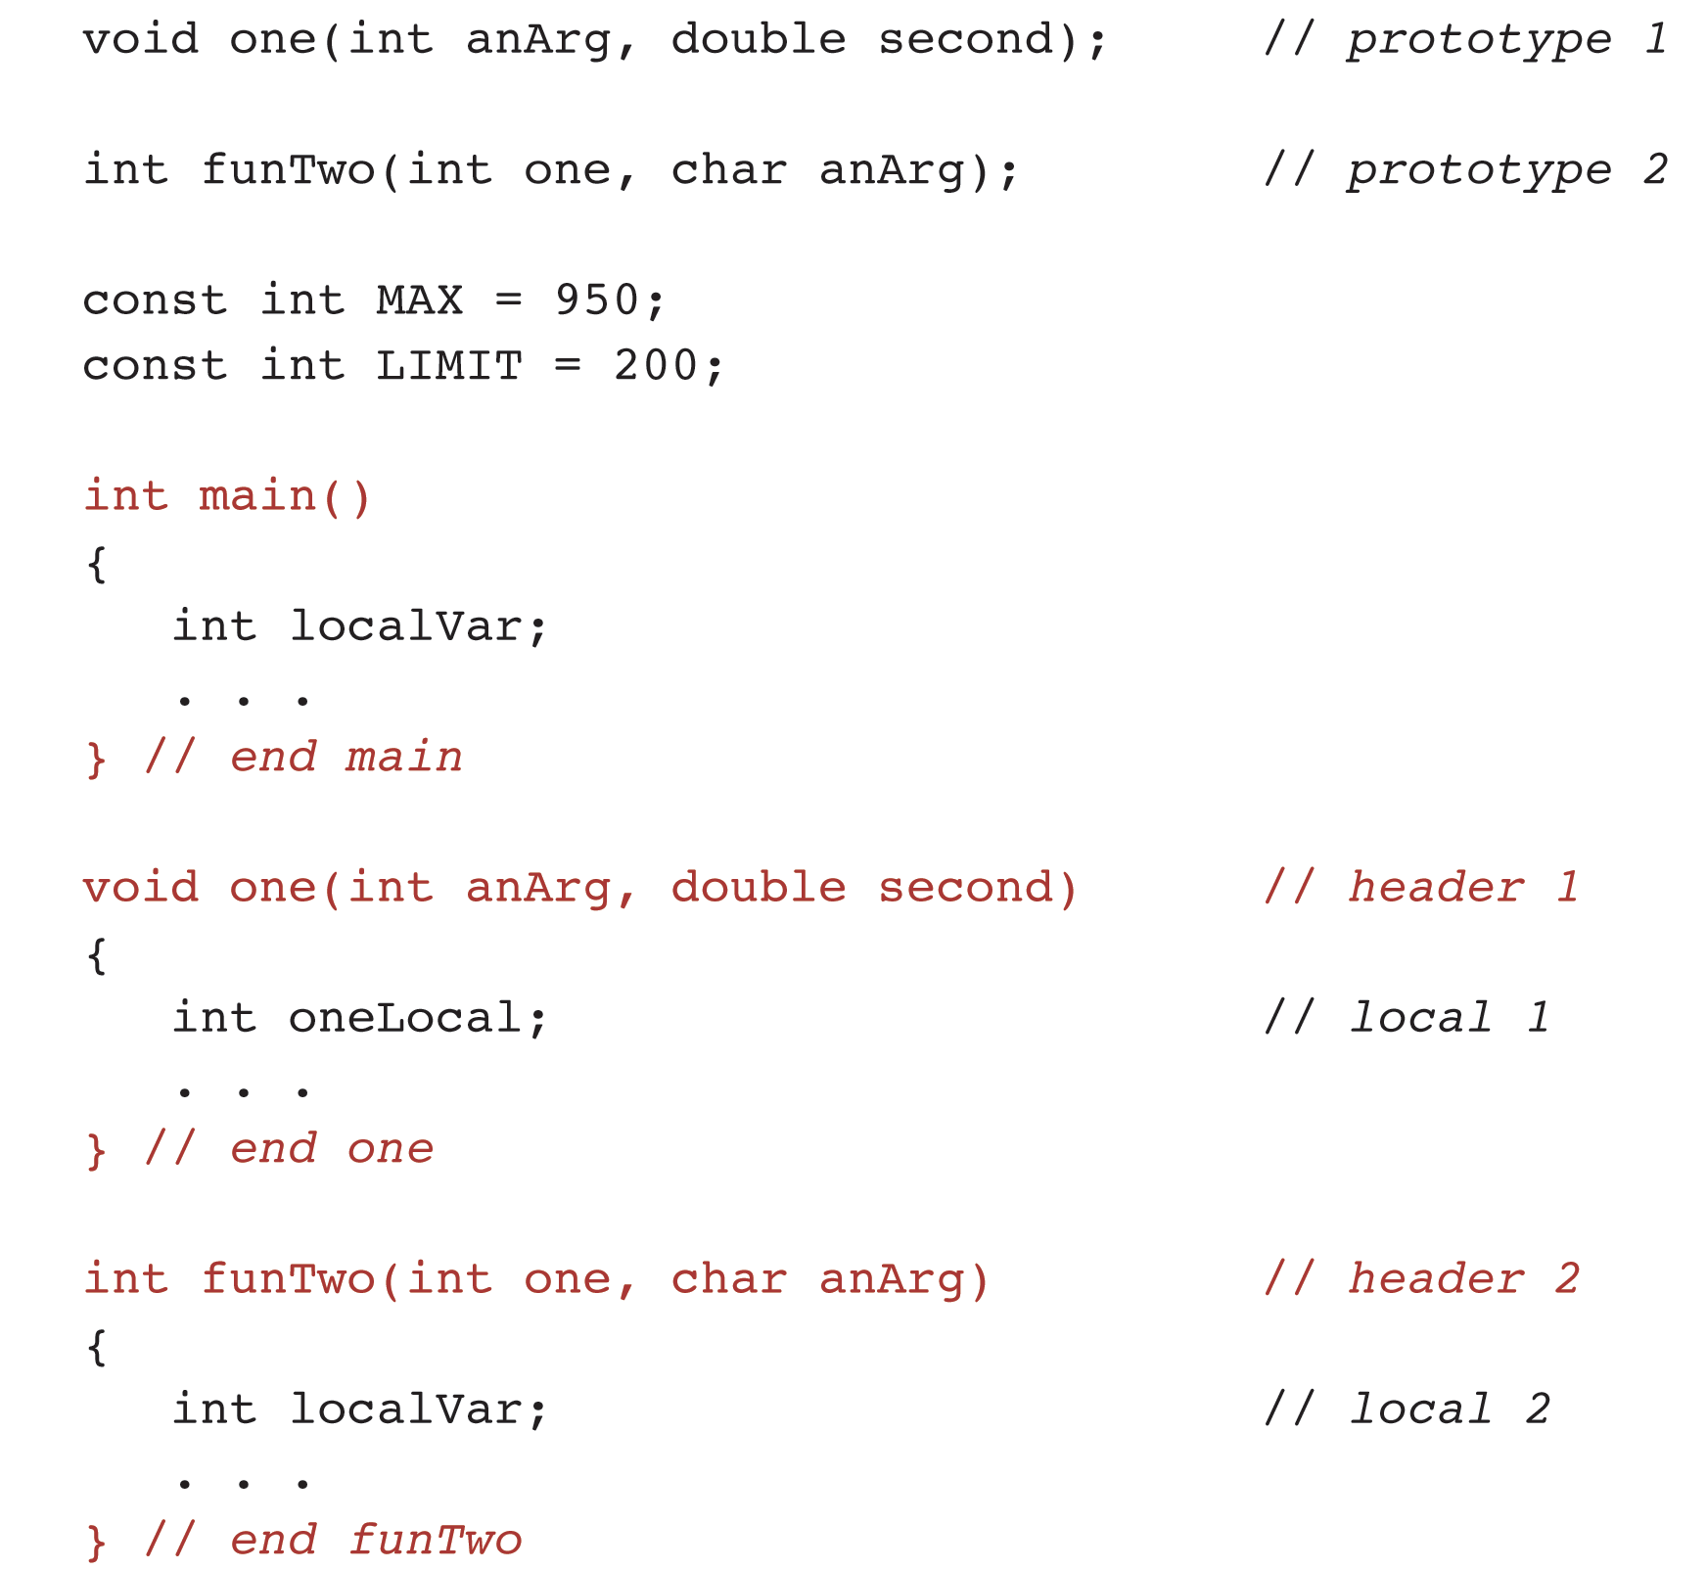
Scope of Names

Slide 50
What Will Be the Output?
#include <iostream>
using namespace std;
const int test = 1;
void info(int test) {
cout << test << endl;
}
void info2() {
cout << test << endl;
}
void info3() {
int test = 3;
cout << test << endl;
}
int main() {
info(test);
int test = 10;
info(test);
info2();
info3();
}

Slide 51
Using Class string
Data abstraction is one of the main principles of OOP
  Facilitated in C++ by using the class construct
  Enables programmers to define new data types and their associated operations
  The user-defined data types are treated like built-in data types and can be used to declare variables, parameters and return types
The string class is part of the C++ standard library:
  #include <string>

Slide 52
String Objects
Attributes of a string object are:
  Character sequence it stores
  The string length
Common operators that can be used with strings:
  <<, >>, =, +, <, >
Declaring string objects:
string firstName, lastName;
string greeting = "Hello";

Slide 53
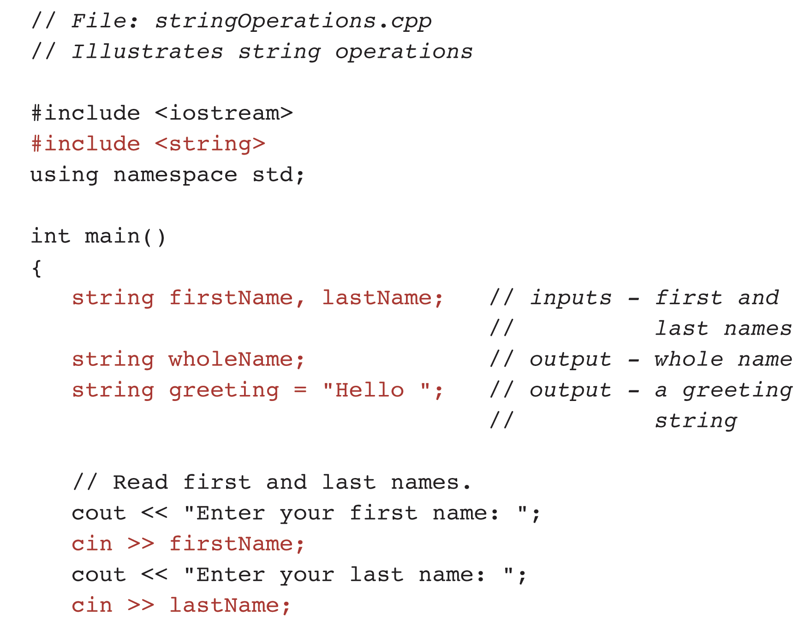
Example: String Operations

Slide 54
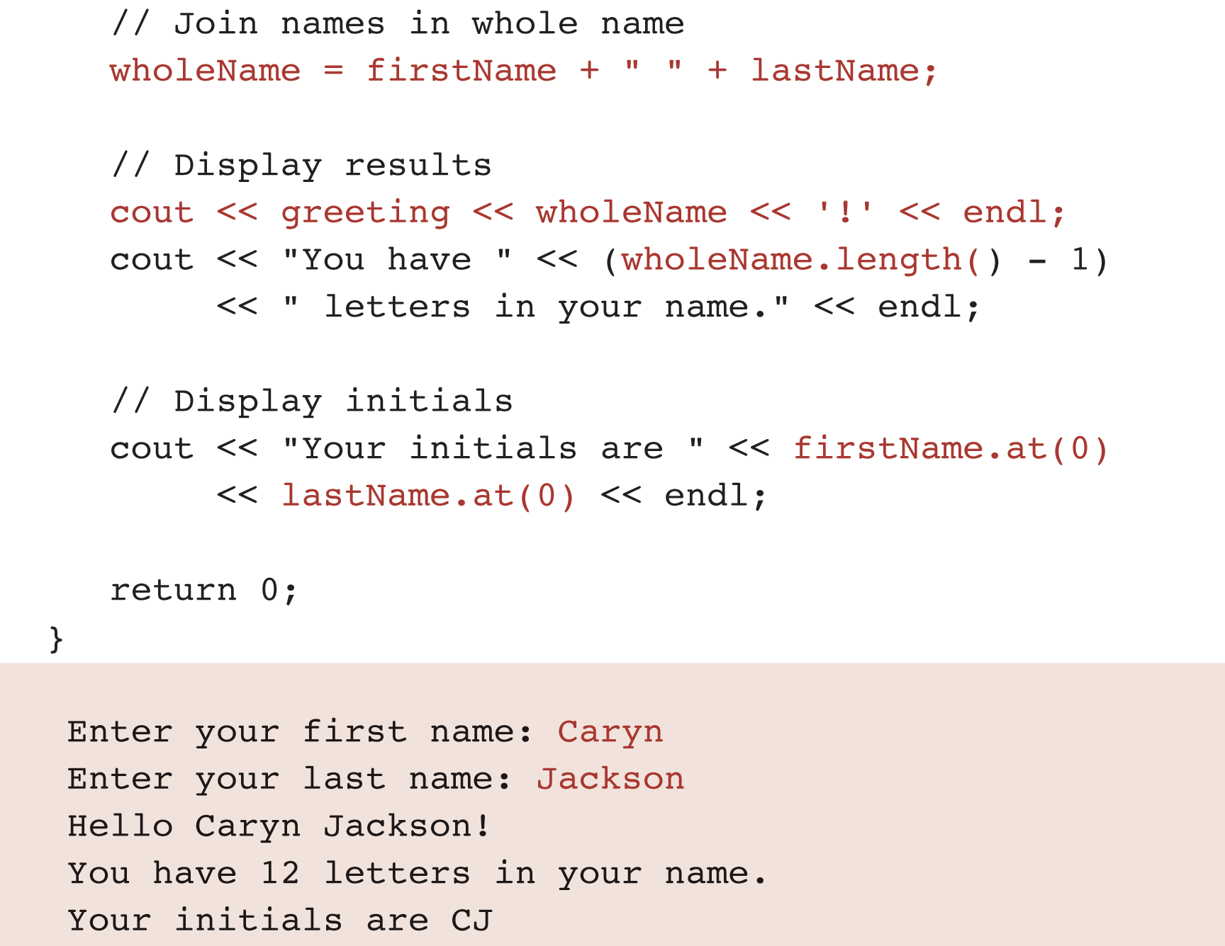
Example: String Operations (continued)

Slide 55
Reading and Displaying Strings
The extraction operator is defined for strings:
cin >> firstName; // reads up to blank or return
The insertion operator is defined for strings:
cout << greetings << wholeName << '!' << endl;
To read a string containing blanks you can use:
getline(cin, lastName, '\n');
// reads all characters up to but
// not including the newline '\n' character

Slide 56
String Assignment and Concatenation
The assignment statement below stores in wholeName the new string formed by joining the three strings that are operands of the + operator:
  wholeName = firstName + " " + lastName;
When used with strings, the operator + is meant to join (concatenate) its string operands
To put a space between the first and last names, we join them with the string value " ", not by the character value ' '

Slide 57
Operator Overloading
Usually the operator + will be used for addition of two numbers
That operator has been redefined (overloaded) to perform concatenation when applied on two strings
The ability of an operator to perform different operations depending on the data type of its operands is called operator overloading
Operator overloading is useful when defining new data types

Slide 58
Accessing String Operations
The previous example also uses member functions length and at from the string class
These functions are called using the dot notation – applies the identified operation on the named object
For example:
  int len = wholeName.length();
  returns the length of the string currently stored in the variable wholeName

Slide 59
Dot Notation
Syntax:
  object.function-call
Example:
firstName.at(0)
The above example returns the character in firstName that is at position 0 (the first character in the string)

Slide 60
Additional string Member Functions
Searching for a string
wholeName.find(firstName);
Inserting characters into a string
wholeName.insert(0, "Ms.");
Deleting portion of a string
wholeName.erase(10, 4);
Assign a substring to a string object
title.assign(wholeName, 0, 3);

Slide 61
Questions?
Q & A

